Slide 1
FROM DEVELOPMENT TO MANAGEMENT CHALLENGE OF NEW BUILT ASSET IN UAE/ABU DHABI
By
Dr. Mohan Guruswamy Dr. M. Gordon Brown
Aldar Properties PJSC Space Analytics
Fellow University of Cambridge Urban Land Institute

Slide 2
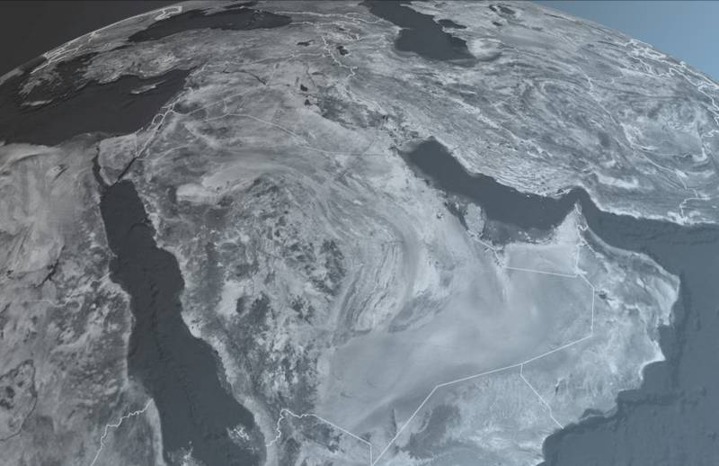
ABU DHABI - United Arab Emirates
Kuwait
Cairo
Dubai
Doha
Abu Dhabi
Riyadh
Muscat

Slide 3
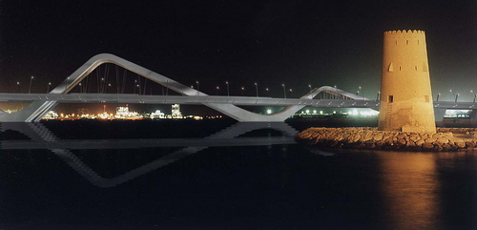
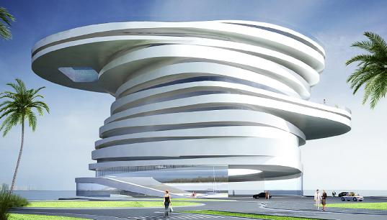
Sheikh Zayed Bridge
Iconic Projects of Abu Dhabi
Ferrari World
Helix Hotel
Mirage Hotel

Slide 4
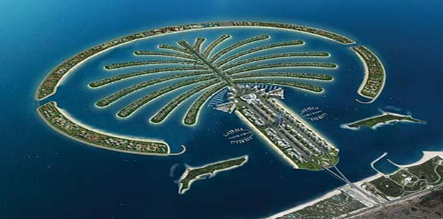
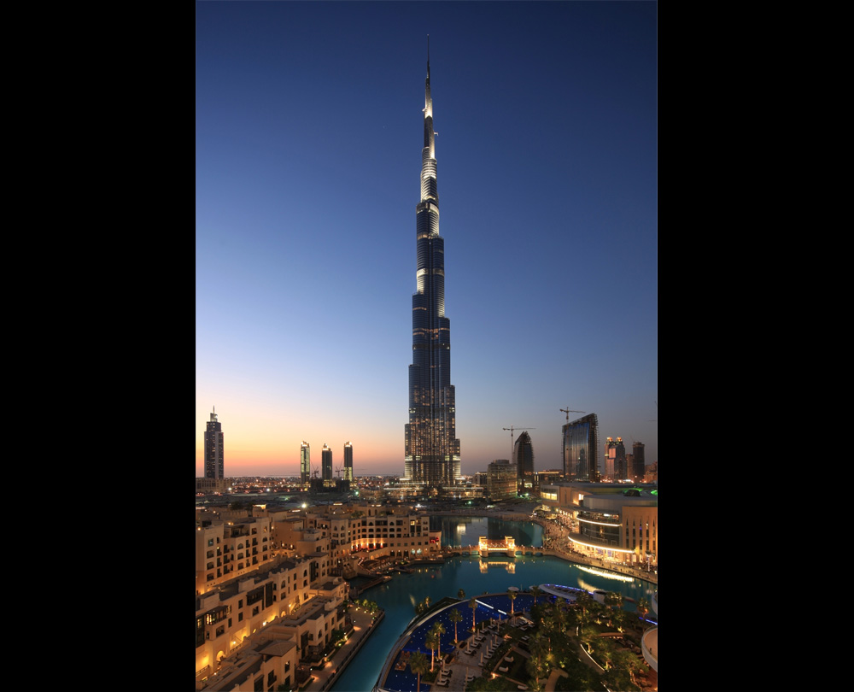
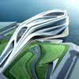
Iconic Projects of UAE
The Louvre
Palm Jumeirah
Abu Dhabi Performing Arts Centre
Burj Khalifa

Slide 5
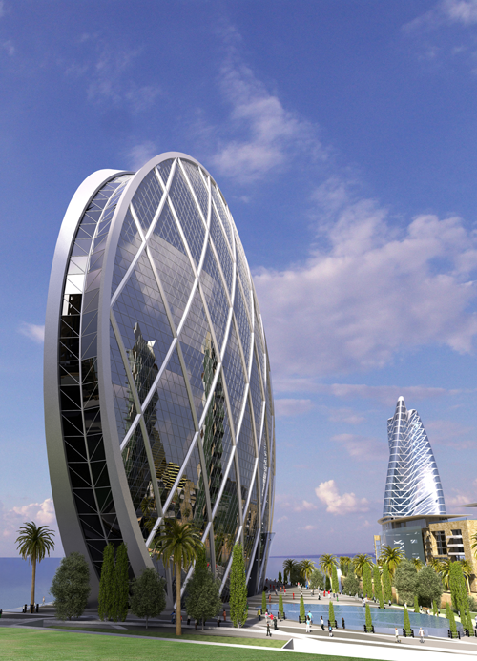
ALDAR Headquarters
The World’s Best Futuristic Design BEX Award 2008

Slide 6
Abu Dhabi Statistics
 | 2005 | 2007 | 2008 | 2009
GDP(Million US $) | 105,050 | 149,416 | 182,666 | 149,720
Per Capita GDP (000 US $) | 76.5 | 99.3 | 116.0 | 91.2
Per Capita Annual Growth % | 26.1 | 6.0 | 17.0 | -21.5
Construction (Million US $) | 7,211 | 12,887 | 14,343 | 15,130
Construction (Growth Rate in %) | 25.6 | 27.4 | 11.3 | 5.5

Slide 7
UAE GDP Forecast

Slide 8
IMF UPDATE – APRIL 2011
UAE Economy is expected to expand at a steady pace averaging 4% growth over the course of next 4 years.
 | 2011 | 2012
GLOBAL GDP | 4.4% | 4.5%
M.E. GDP | 4.1% | 4.2%
UAE GDP | 3.3% | 3.8%

Slide 10
UAE’s PROJECTS – FOCUS ON HIGH-END MARKET
DIFFERENTIATION
HYBRID
4
8
HIGH
5
6
7
FOCUSSED DIFFERENTIATION
3
2
1
BURJ AL ARAB
ALRAHA BEACH
PALM JUMEIRAH
BURJ KHALIFA
FERRARI WORLD
Aldar HQ
ALFALAH
PERCEIVED ADDED VALUE
LOW PRICE
LOW
NOFRILLS
LOW
PRICE
HIGH

Slide 11
CHALLENGES FACED
PHENOMENAL GROWTH IN SHORT TIME
Average 15% to 20% Growth Per Annum
LACK OF WHOLISTIC VIEW
Absence of an Integrated Approach Across Lifecycle
CHANGE IN SKILL MIX REQUIREMENT
Functional Competencies Required for Operations/Management are Different from Development
CAPABILITY BUILDING FOR OPERATION/ MANAGEMENT
Lack of Proactive Thinking to Build Capability for Operation/Management
LIMITED UNDERSTANDING OF MARKET & CUSTOMERS
Inadequate Customer Focus in Development Stage
SHIFT IN DEMAND PATTERN
From High End Housing to Economical Housing
From Premium Retail/Commercial Space to Affordable Space
EMPHASIS ON COST REDUCTION
Developers Focus on Cost Reduction and Operators/Managers Focus on Value for Customers

Slide 12
APPROCAHES TO OVERCOME CHALLENGES
CAPABILITY BUILDING
Establish An Academy to Develop Competencies in Managing Built Environment
LIFE-CYCLE PERSPECTIVE
Integrated Approach Encompassing Entire Lifecycle
STRATEGIC FIT BETWEEN MARKET DEMAND & PRODUCT DEVELOPMENT
Follow STP Marketing; Build To Demand
FLEXIBLE CONSTRUCTION SYSTEM
More Proactive Response to Market Trend
REAL ESTATE REGULATION AND LAW
Government To Establish Clear Laws and Regulations
VALUE PROPOSITION
In Development Stage, Greater Emphasis on Value for Money than Cost Reduction

Slide 13
THANK YOU

