Slide 1
Value at Risk : a specific real estate model
Direct real estate value at Risk
Charles-Olivier AMEDEE-MANESME, Thema U. Cergy-Pontoise
Fabrice BARTHELEMY, Thema U. Cergy-Pontoise
Notes:
gfgy

Slide 2
Motivation?
Calculation rare in real estate.
However financial institutions face now the important task of estimating and controlling their exposure to market risk following a scope of new regulation (Basel II, Basel III, Solvency II or NAIC’s risk based).
Therefore financial institutions that have exposure to real estate market risk may use internal models to estimate it.

Slide 3
Literature
Value at Risk in stocks or bonds
Pritsker (1996): Monte-Carlo simulation;
Zangari (1996a), Longerstaey (1996): Johnson transformations;
Zangari (1996b), Fallon (1996): Cornish-Fisher expansions;
Britton-Jones and Schaefer (1999): Solomon-Stephens approximation;
Li (1999): Moment-based approximations ;
Feuerverger and Wong (2000): Saddle-point approximations;
Rouvinez (1997), Albanese et al. (2000): Fourier-inversion
Longin (2000): Extreme value theory.
Ph. Jorion, Value at Risk, book, 2006
Value at Risk in real estate
Gordon and Wai Kuen Tse (2003)
Hoesli and Hamelink (2004)
Baroni, Barthélémy and Mokrane (2007)
Liow (2008)
Zhou and Anderson (2010)
Brown and Young (2011)

Slide 4
VaR calculation: The 3 main methods
The following calculation methodology are widely accepted among academics and practitioners:
Historical Method
  simply re-organizes actual historical returns
  putting them in order from worst to best
  then assuming that history will repeat itself (from a risk perspective)
The Variance-Covariance Method (VaR Metrics JPM, 1996)
  assumes that returns are normally distributed
  estimation of return and standard deviation
  then plotting a normal distribution curve
Monte Carlo Simulation
  randomly generates trials
  generating of random outcomes
Notes:
The idea behind the variance-covariance is similar to the ideas behind the historical method - except that we use the familiar curve instead of actual data. The advantage of the normal curve is that we automatically know where the worst 5% and 1% lie on the curve. They are a function of our desired confidence and the standard deviation ():

Slide 5
Reference cases
 |  | Portfolio # 1 | Portfolio # 2
Strategy |  | Core | Opportunistic
Nb properties |  | 10 5 in France 5 in Germany
Nb spaces |  | 13 7 in France 6 in Germany
Portfolio Value |  | 1000
Market rental value |  | 60,3 | 80
Passing rent |  | 60 | 29,5
Vacancy rate |  | 0% | 63%
Nb vacant space |  | 0 | 8
Average state of property |  | 1,3 | 4,3
Weighted average lease length |  | 6,7 years | 1,6 years
Lease structure in case of BO |  | France: 6/9 Germany: 5/10

Slide 6
Reference cases
 |  | Portfolio # 1 | Portfolio # 2
Strategy |  | Core | Opportunistic
Nb properties |  | 10 5 in France 5 in Germany
Nb spaces |  | 13 7 in France 6 in Germany
Portfolio Value |  | 1000
Market rental value |  | 60,3 | 80
Passing rent |  | 60 | 29,5
Vacancy rate |  | 0% | 63%
Nb vacant space |  | 0 | 8
Average state of property |  | 1,3 | 4,3
Weighted average lease length |  | 6,7 years | 1,6 years
Lease structure in case of BO |  | France: 6/9 Germany: 5/10
Possible states of a property
1: New or completely refurbished 2: very Good state 3: Good condition 4: In need of some attention 5: Old 6: To be refurbished

Slide 7
PMA: Capital growth

Slide 8
PMA: Rental growth

Slide 9
VaR with traditional model
Strategy |  |  | Portfolio # 1 | Portfolio # 2
 |  |  | Core | Opportunistic
Historical method | 5% |  | 25% | 25%
 | 1% |  | NaN | NaN
Variance-Covariance | 5% |  | 23% | 23%
 | 1% |  | 31% | 31%
Monte-Carlo (GBM) | 5% |  | 23% | 23%
 | 1% |  | 32% | 32%
Bootstrapping | 5% |  | 21% | 21%
 | 1% |  | 21% | 21%

Slide 10
Specificities to take into account
Lease structure
Cost of vacancy
Length of vacancy
Probability of vacancy
Depreciation (obsolescence)
…
Capital expenses (redevelopment and refurbishement)

Slide 11
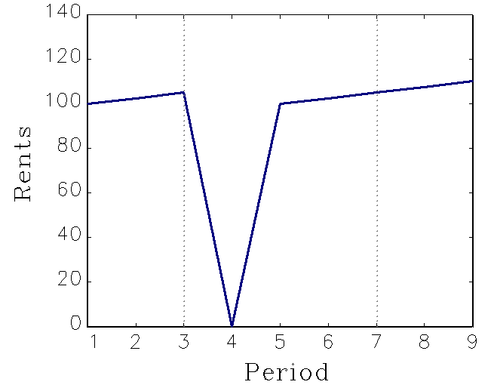
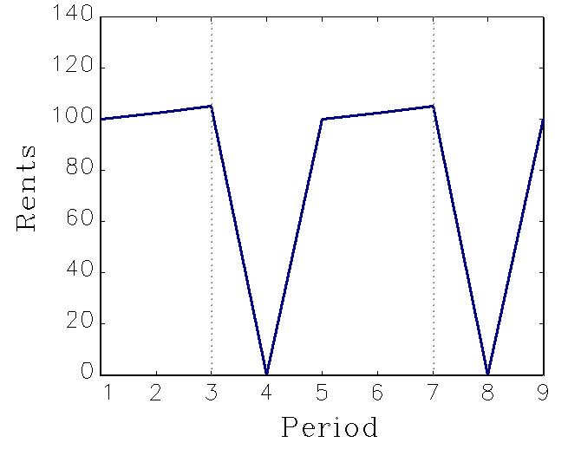
Continental Europe lease contract: the structure
Lease structures vary across countries
Long lease (5 to 10 years)
Usually tenants have options to leave during the course of the lease: Break-Option “BO”
At the time of a BO the tenant has two possibilities:
    Staying
    Leaving
At the time of a BO the Landlord has no decision to take but can enter into negotiation
Rents usually indexed (Except UK)
  Inflation
  Country specific index
  Fixed indexation
  Upward only review

Slide 12
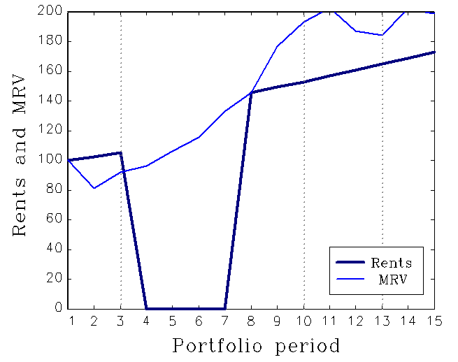
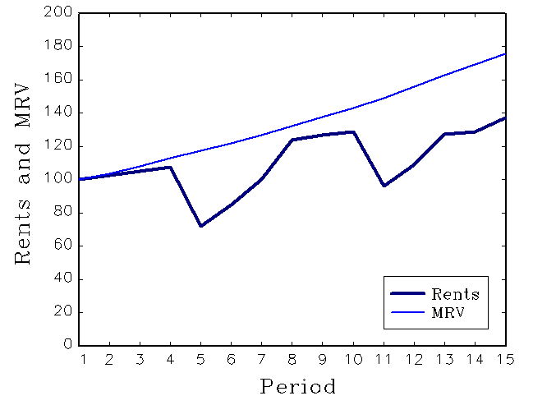
Lease structure, Amédée-Manesme, Baroni, Barthélémy and Dupuy (working paper, 2011)*
Two possibilities for a tenant facing a break-option: leaving or staying.
The option to leave is exercised by the tenant only if at the time of a possible break option the rent currently paid is too high in comparison to the current market rental value:
If a property is priced above the current market value, more competitively properties will rent while the overpriced property will sit vacant.
The vacancy length is modeled using a Poisson’s law.
* Presented in the 2012 AREUEA annual conference in Chicago
1 path
10 000 paths
3/6/9 year lease contract
Indexation 2.5%/year
MRV~N(2%,10%)

Slide 13
Cost of vacancy
Vacancy cost in real estate is the amount of money that is estimated to be paid due to vacant units.
  In most rental contract, current expense are paid by the tenant, only large capital expense are paid by the landlord
  Particularly high real estate investment (security, A/C system, maintenance…)
  Occur only in case of vacancy
Vacancy cost is a function of time. The more time a property sits vacant, the more it costs.
We propose to take the vacancy cost into account when computing the value at risk;
  Generally, a percentage that is comparable to similar properties is used to estimate the vacancy cost for a subject property;
  Here we use 15% of the rental value of the unit:
If a space is vacant at time t and exhibits a MRV_{t}=100, then Rent_{t}=(15)

Slide 14
Obsolescence
The obsolescence is a significant decline in the competitiveness, usefulness, or/and value of a property.
Obsolescence occurs generally due to the availability of alternatives that perform better or are cheaper or both or due to change in users’ preferences, requirement or style.
However, we do not find any database that allows us to reliably determine the function of obsolescence of a property.
To account for obsolescence, we only assess:
We use in our model a linear erosion in value of the property (except land part)
Note: obsolescence is distinct from fall in value (depreciation) due to physical deterioration
Note 2: insurance companies already take obsolescence into account to reduce the amount of claim to be paid on damaged property

Slide 15
Probability of vacancy
The state of a property is a fundamental part of its value;
The state of a property is also fundamental in order to remain attractive to tenant
    maintaining tenant in an old or obsolete asset can be a rough task;
    in the same way, leasing an old or obsolete property is more difficult.
Formalizing and quantifying the risk of becoming vacant is essential to get a good understanding of real estate’s unique risk.
We consider the probability of being vacant increases with the level of obsolescence of a property. Therefore:
In order to account for the probability of being vacant, we decrease the level of decision criteria when the state of the property decrease…
Reminder:

Slide 16
Length of vacancy
The length of vacancy is modeled using a Poisson’s law:
The average vacancy length is represented by the parameter λ.
An old or obsolete asset may remain vacant for a longer period of time than a recent one.
Therefore:

Slide 17
Summary results: VaR_{5%} & VaR_{1%}
Strategy |  |  | Portfolio # 1 | Portfolio # 2
 |  |  | Core | Opportunistic
Historical method | 5% |  | 25% | 25%
 | 1% |  | NaN | NaN
Variance-Covariance | 5% |  | 23% | 23%
 | 1% |  | 31% | 31%
Monte-Carlo | 5% |  | 23% | 23%
 | 1% |  | 32% | 32%
Bootstrapping | 5% |  | 21% | 21%
 | 1% |  | 21% | 21%
Lease structrure | 5% |  | 22% | 38%
 | 1% |  | 28% | 47%

Slide 18
Summary results: VaR_{5%} & VaR_{1%}
Strategy |  |  | Portfolio # 1 | Portfolio # 2
 |  |  | Core | Opportunistic
Lease structrure | 5% |  | 22% | 38%
 | 1% |  | 28% | 47%
Lease structure + Cost of vacancy | 5% |  | 22% | 41%
 | 1% |  | 28% | 51%
Lease structure + Cost of vacancy + Probability of vacancy + Length of vacancy | 5% |  | 23% | 48%
 | 1% |  | 29% | 57%
Lease structure + Cost of vacancy + Probability of vacancy + Length of vacancy + Depreciation | 5% |  | 24% | 50%
 | 1% |  | 30% | 58%

Slide 19
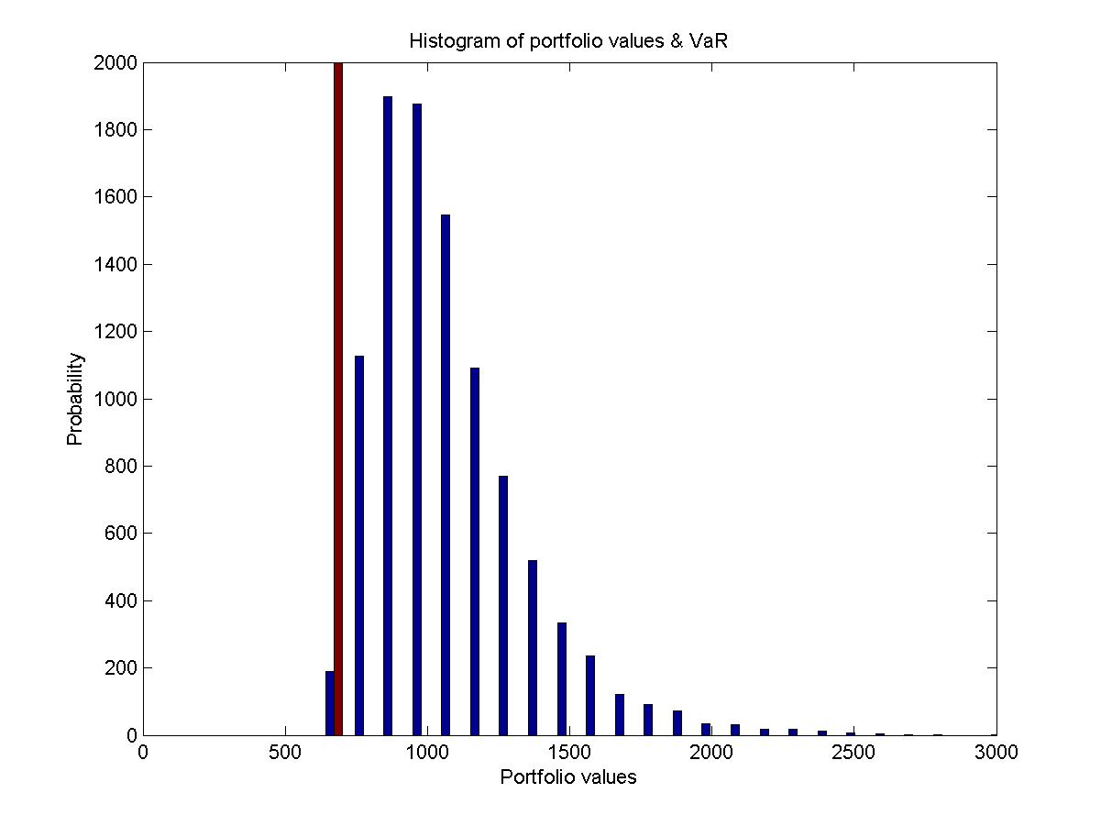
Portfolio 1: lease structure + Cost of vacancy + Probability of vacancy + Length of vacancy + Depreciation

Slide 20
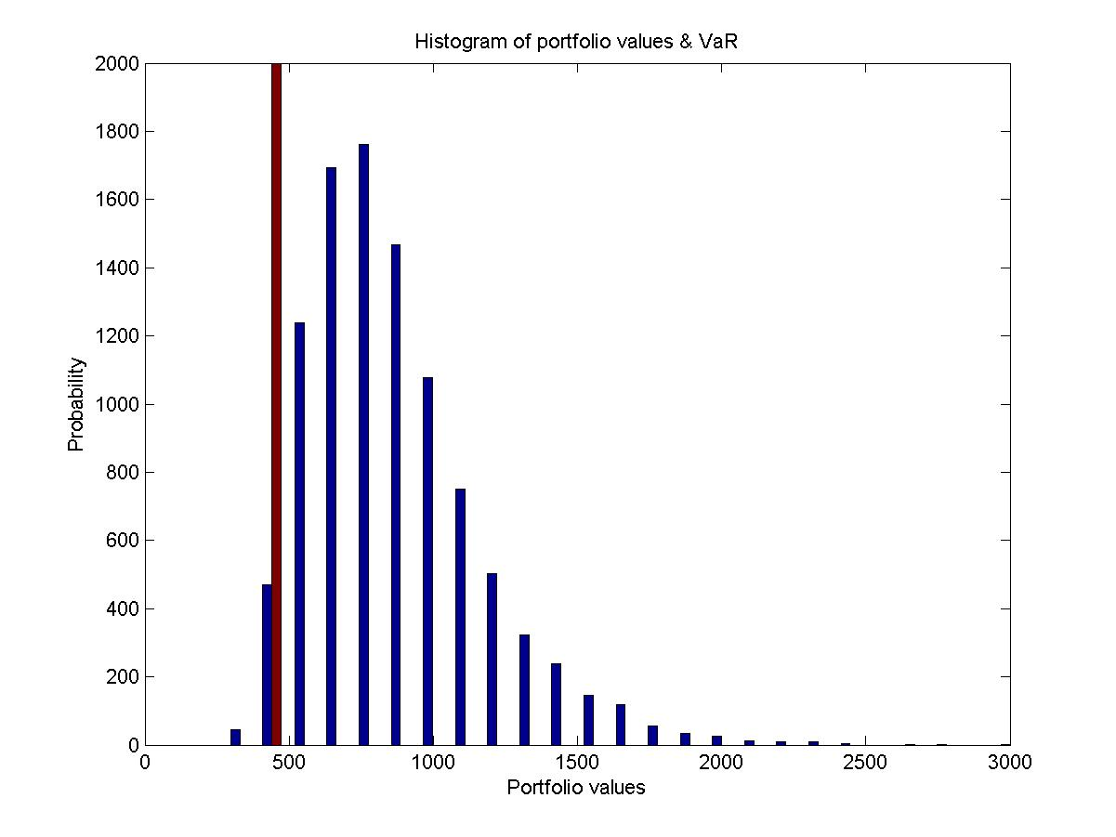
Portfolio 2: lease structure + Cost of vacancy + Probability of vacancy + Length of vacancy + Depreciation

Slide 21
Conclusions
The Value at Risk is strongly impacted by the lease structure;
Vacancy costs, probability of vacancy, length of vacancy or obsolescence also have a huge impact on the Value at Risk.
Using a model that considers the specificities of a real estate investment allows to compute more robust and more relevant Value at Risk;
Such a model enables in particular to discriminate between investment strategies: VaRRisky strategy > VaRCore strategy
Real estate risk managers and investors have to be aware of the impact of all these characteristics when considering the risk or the required capital.

Slide 22
Questions?

Slide 23
Future research
Finding a database with all the parameters in order to determine accurately laws and numbers
Taking the leverage into account
Using a negotiation model based on American option theory
    The landlord and/or the tenant may be tempted to enter into negotiation in order to hedge against vacancy according to their expectation of the future…
Taking the strategy into account
    Allowing landlord to negotiate the departure of a tenant
    Allowing change in strategy (drop off of the expected rents)

Slide 24
Appendices

Slide 25
Value at Risk: Definition
Maximum potential loss given a specific time horizon and a confidence interval.
Used for
    Risk management,
    Financial reporting
    Capital requirement
Mathematical definition: given some confidence level α , the VaR of the portfolio is given by the smallest number l such that the probability that the loss L exceeds l is not larger than (1 – α):
Or as well by considering a position X with its cumulative distribution function F_{X} and q_{α}(X) the lower quartile by:

Slide 26
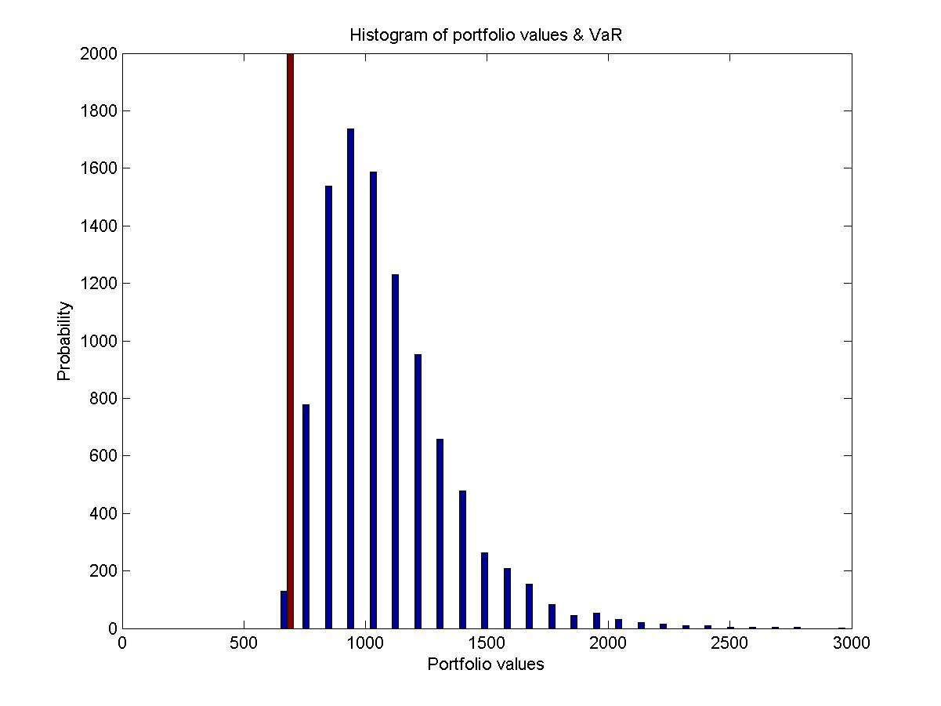
Portfolio 1: lease structure

Slide 27
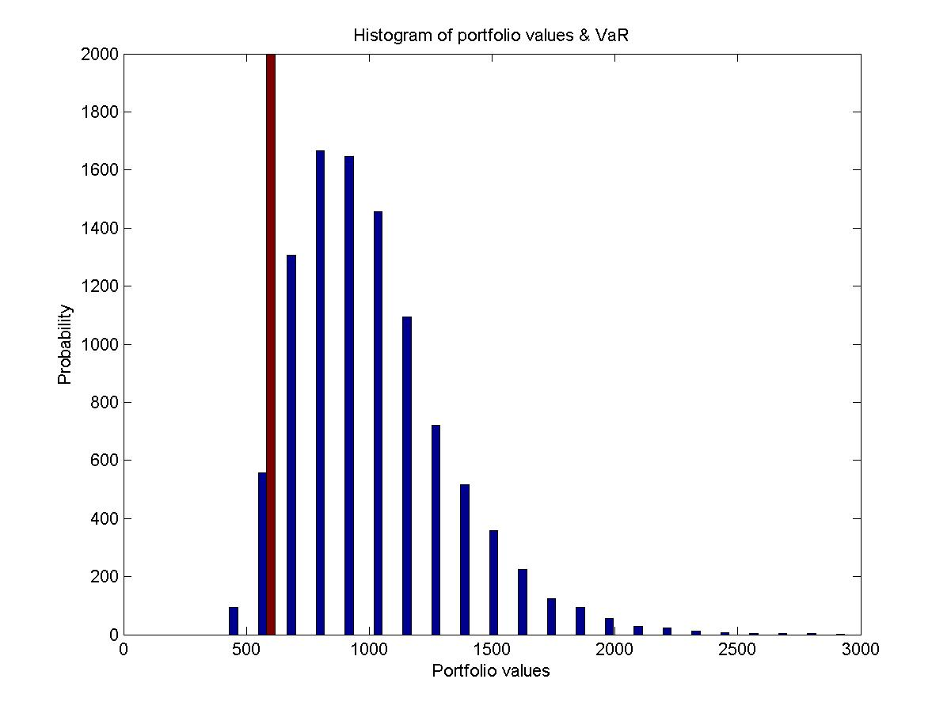
Portfolio 2: lease structure

Slide 28
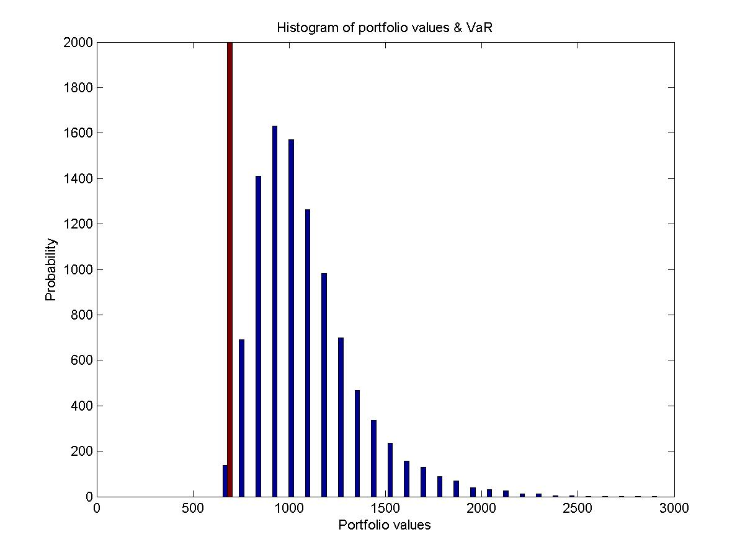
Portfolio 1: lease structure +Cost of vacancy

Slide 29
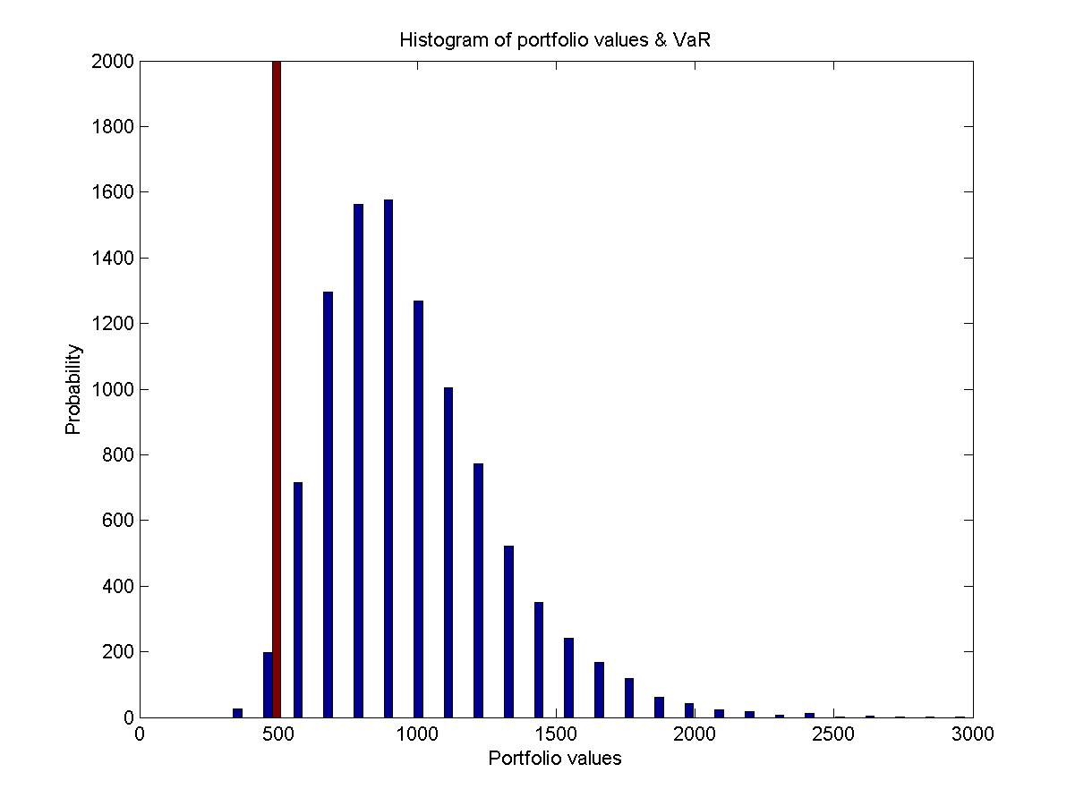
Portfolio 2: lease structure +Cost of vacancy

Slide 30
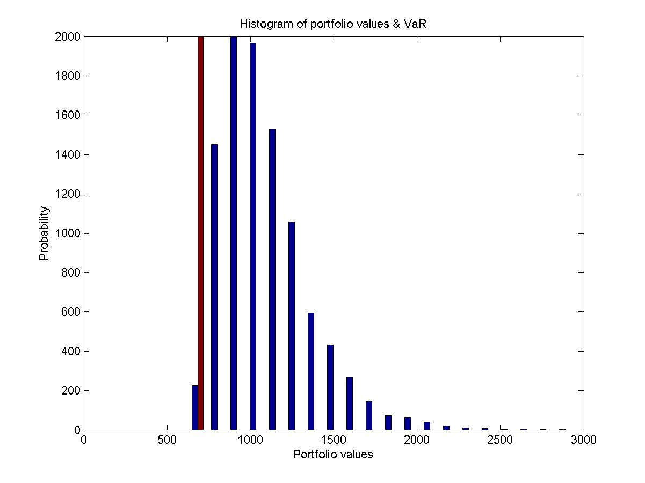
Portfolio 1: lease structure + Cost of vacancy + Probability of vacancy + Length of vacancy

Slide 31
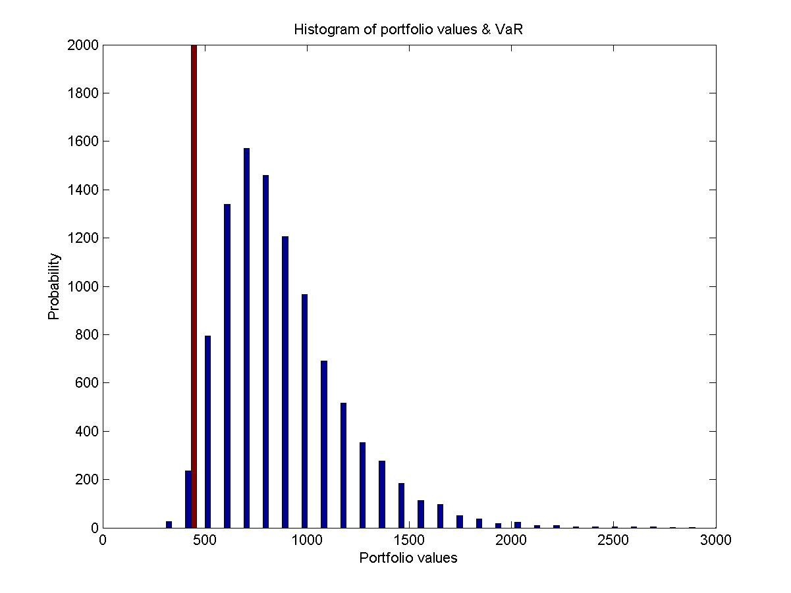
Portfolio 2: lease structure + Cost of vacancy + Probability of vacancy + Length of vacancy

