Slide 1
Labeled Properties = Prime Locations?
A Spatial View On The Diffusion Of Green Buildings
Bucharest, June 27th 2014
Thomas Braun | Marcelo Cajias | Sven Bienert

Slide 2
Agenda
Introduction
Literature Review
Hypothesis
Research Approach
Results
Conclusion

Slide 3
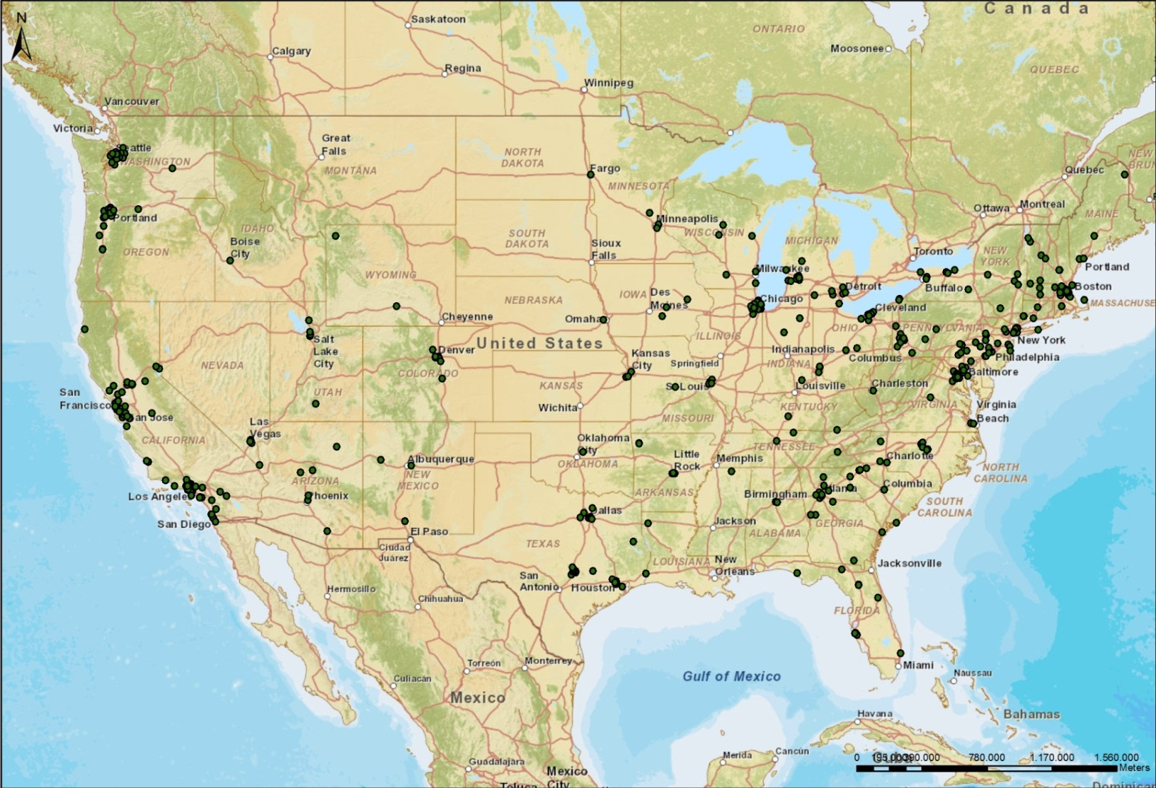
Introduction
LEED registered Buildings in 2003

Slide 4
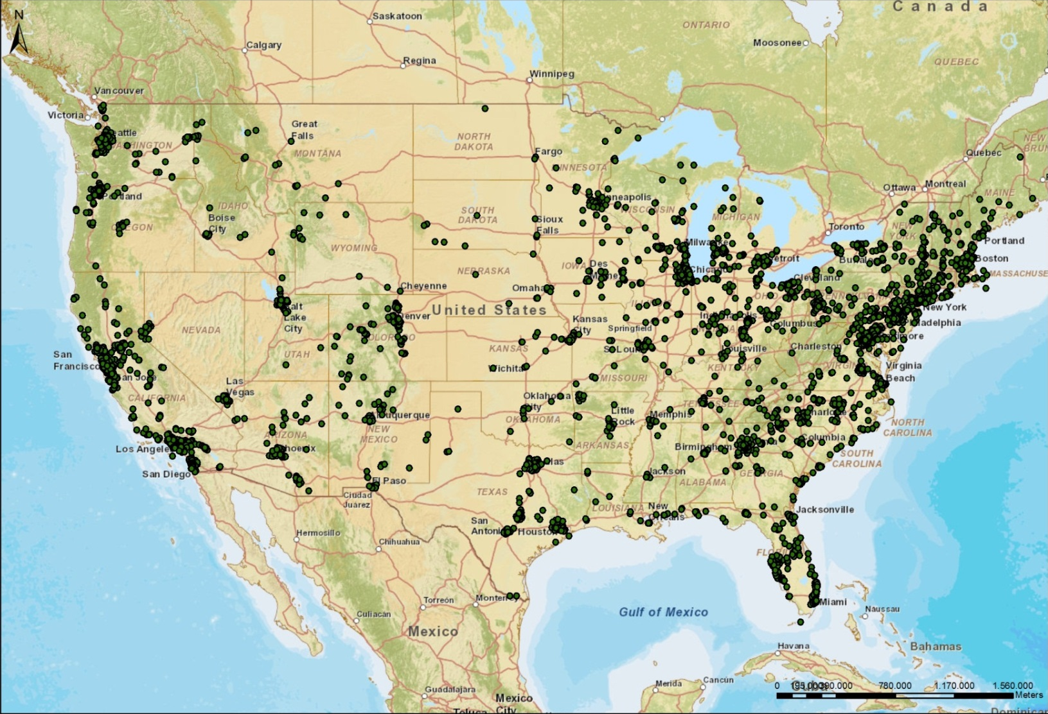
Introduction
LEED registered Buildings in 2007

Slide 5
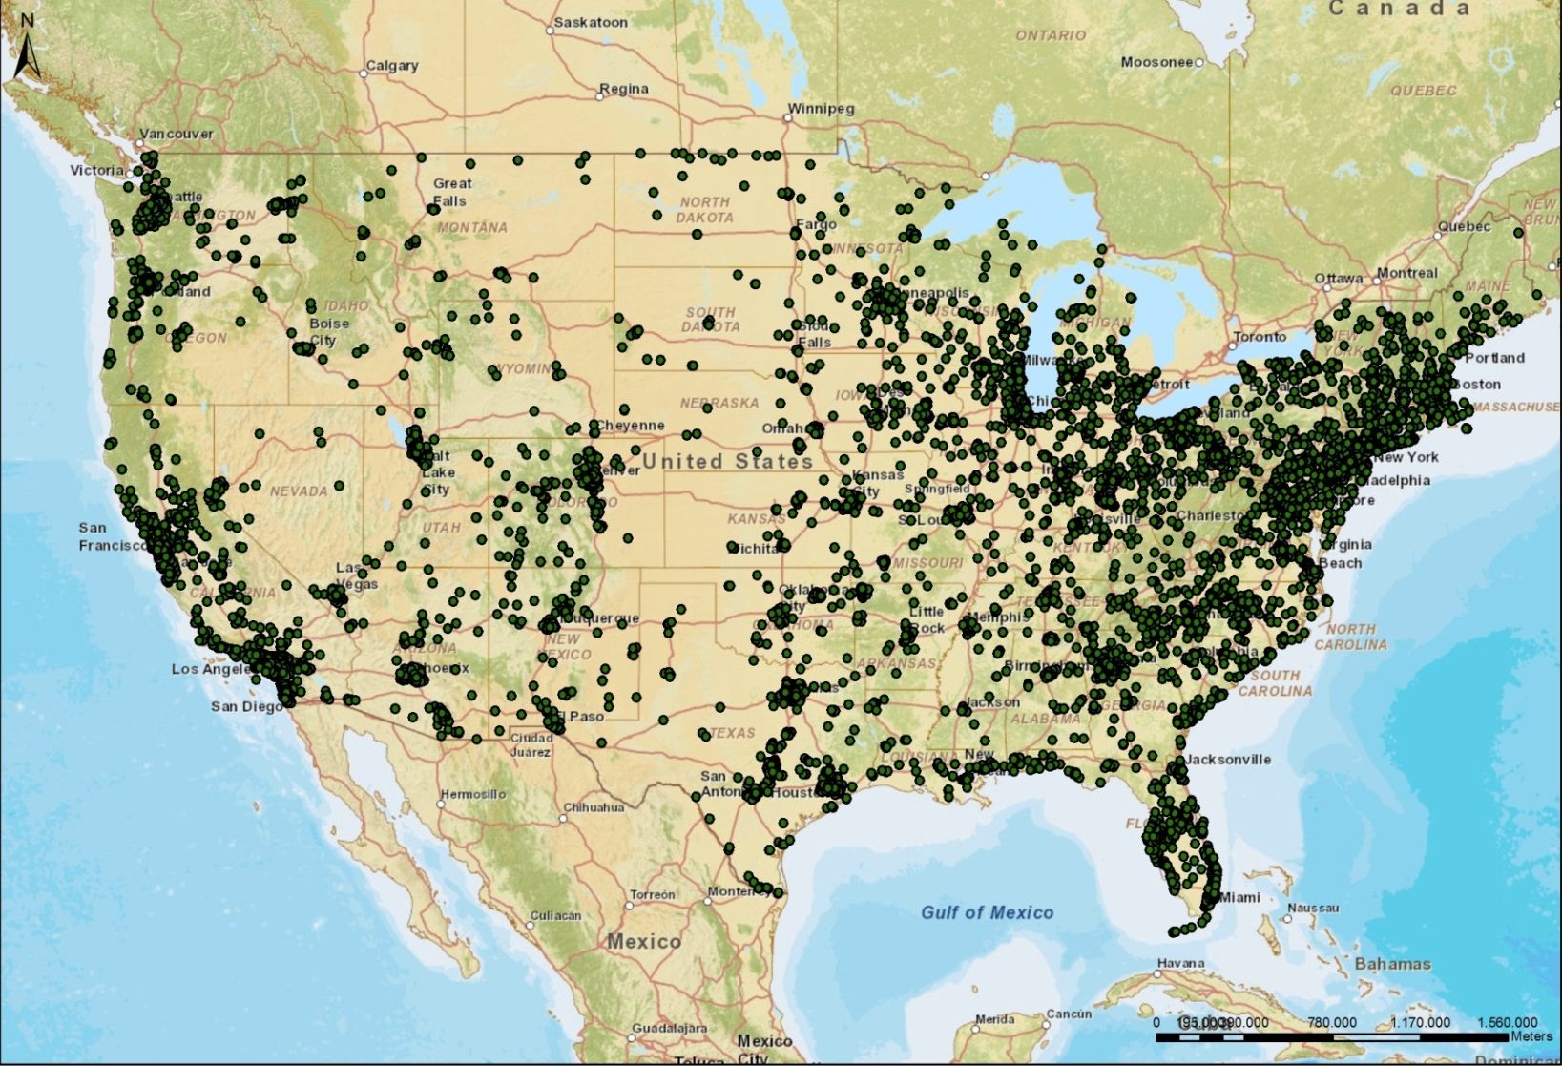
Introduction
LEED registered Buildings in 2010

Slide 6
Literature Review
Embedding Diffusion
  Diffusion in general = Spreading over space and time
  Geographical: Spread of information, innovation and human activity in space ➔ Hägerstrand (1953)
    Expansive Diffusion (a)
    Relocating Diffusion (b) – Special form: Hierarchical Diffusion
  Innovations usually start in larger agglomerations and gradually exploit lower-ordered areas
(a)
(b)
Notes:
Usually: hierarchical downwards process starting in innovative, economical strong areas (globalization and decreasing importance of distance)

Slide 7
Literature Review
Change from an initial predominance in large coastal cities to a more uniform spatial distribution
Authors | Year | Journal/ Publication
Antonopoulos | 2013 | Dissertation
Cidell | 2009 | The Professional Geographer
Choi | 2010 | The Korean Journal of Policy Studies
Choi, Miller | 2011 | Journal of Sustainable Real Estate
Fuerst et al. | 2014 | Environment and Planning B
Gauthier, Wooldridge | 2012 | Business Strategy and the Environment
Johansson | 2011 | International Journal of Technology Management & Sustainable Development
Kahn, Vaughn | 2009 | B.E. Journal of Economic Analysis & Policy
Kaza et al. | 2013 | Urban Studies
Kok et al. | 2011 | American Economic Review
Kontokosta | 2011 | Journal of Sustainable Real Estate
Malkani, Starik | 2013 | Journal of Sustainable Real Estate
Marker et al. | 2014 | Performance Improvement Quarterly
Simcoe, Toeffel | 2012 | NBER Working Paper
Pacific Area and New England as innovating regions
Expansive diffusion from the coast to the interior
Hierarchical Diffusion confirmed on regional level but denied on city level
“Strong evidence is found of clustering at the metropolitan and sub-metropolitan scales.”
Urban areas dominate the green building markets.
Mixed rural counties are becoming more common.
Green buildings are locating more closely to one another over time (contagion or spillover effects)
Different metropolitan regions experience different types of cluster formations.
➔ Lack of micro-level diffusion studies
Notes:
Cidell: Change from an initial predominance in large coastal cities to a more uniform spatial distribution
➔ Solely macro view
Johansson: Pacific Area and New England as innovating regions; Expansive diffusion from the coast to the interior; Hierarchical Diffusion confirmed on regional level but denied on city level
➔ Solely macro view
Kaza: “Strong evidence is found of clustering at the metropolitan and sub-metropolitan scales. […] While urban areas continue to dominate the green building markets, both LEED and ES buildings are becoming more common in mixed rural counties rather than mixed urban counties. Part of this could perhaps be explained by an increase in building activity at the fringes of urban areas. […] Overall, however, the trend in the past decade has been that both LEED and ES buildings are locating more closely to one another as time goes on. This suggests a contagion or spillover effect. […] Another interesting finding is that different metropolitan regions experience different types of cluster formations. While some regions exhibit an organically growing cluster that is initially seeded, some regions have experienced dispersion and a coalescent pattern of cluster formation.”
➔ Talks about Clusters, no diffusion over time
But, what are the reasons for hierarchical diffusion pathways?
Innovativeness, Communication Channels (Consultants), different D-M-Us because:

Slide 8
Literature Review
Authors | Year | Journal/ Publication
Antonopoulos | 2013 | Dissertation
Cidell | 2009 | The Professional Geographer
Choi | 2010 | The Korean Journal of Policy Studies
Choi, Miller | 2011 | Journal of Sustainable Real Estate
Fuerst et al. | 2014 | Environment and Planning B
Gauthier, Wooldridge | 2012 | Business Strategy and the Environment
Johansson | 2011 | International Journal of Technology Management & Sustainable Development
Kahn, Vaughn | 2009 | B.E. Journal of Economic Analysis & Policy
Kaza et al. | 2013 | Urban Studies
Kok et al. | 2011 | American Economic Review
Kontokosta | 2011 | Journal of Sustainable Real Estate
Malkani, Starik | 2013 | Journal of Sustainable Real Estate
Marker et al. | 2014 | Performance Improvement Quarterly
Simcoe, Toeffel | 2012 | NBER Working Paper
“CSR, company culture, and sustainability initiatives played a part in the organization’s willingness to […] invest the upfront capital necessary for efficiency upgrades in new or existing buildings.”
“Adoption of Leadership in Energy and Environmental Design (LEED) green building certification in the United States was more likely among firms […] strategically positioned as environmental leaders.”
“Both economic and non-economic factors are important in the intention to adopt LEED and ENERGY STAR building technologies.”
➔ CSR/ Image as additional drivers of the diffusion of green buildings
Notes:
We assume CSR, image, environmental awareness being additional drivers of green Buildings.
Antonopoulos: All participants surveyed and interviewed for this study indicated that CSR, company culture, and sustainability initiatives played a part in the organization’s willingness to participate in the CBP program and invest the upfront capital necessary for efficiency upgrades in new or existing buildings.
Gauthier, Wooldridge: “Adoption of Leadership in Energy and Environmental Design (LEED) green building certification in the United States was more likely among firms similarly oriented toward end‐consumers and among firms strategically positioned as environmental leaders.
Malkani, Starik: “Both economic and non-economic factors are important in the intention to adopt LEED and ENERGY STAR building technologies.”

Slide 9
Hypothesis
Implications for Target Groups and Locations
  Costs
  Rejection
  Benefits
  Adoption
  Costs
  Rejection
  Benefits
  Adoption
Image / CSR
  The higher the weight of Image / CSR in a company’s utility function, the more likely is a green building investment
  „Labeled Properties
  = Prime Locations?“
  As the image-related part worth for a company is higher by properties in prime locations, green buildings are most profitable in prime locations
Notes:
Green Building attributes: Relative Advantage partially (depends on D-M-U – CSR, (multi)national companies, interconnectedness)
Labeled Properties = Prime Locations?
We assume a CSR-driven positive influence on the development of green buildings, particularly, displayed in selecting prime locations.

Slide 10
Hypothesis
„Labeled Properties = Prime Properties?“
  In which areas are green buildings actually located? Exclusively in prime locations?
  What happens, if markets in the initial stage (prime locations) are saturated? Do / will new markets (beyond prime locations) be entered by green buildings according to a hierarchical diffusion process? Are there already any indications?

Slide 11
Research Approach
Data
  Focus on the spatial dimension: Yearly diffusion from 2000 to 2012
  Green intention describes the diffusion ➔ Registration date
  Each investment decision is equitable (regardless of a square feet weighting!)
  CBSA-level (103): population > 500,000
  Number of LEED buildings: about 18,000

Slide 12
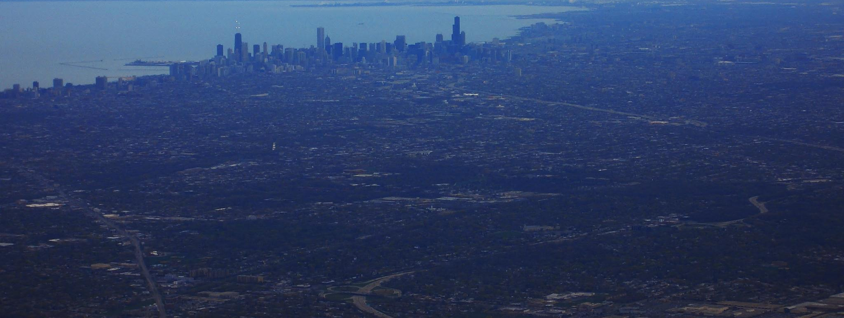
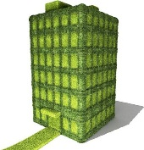

Slide 13
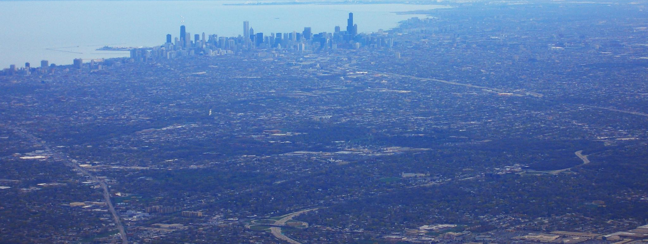

Slide 14
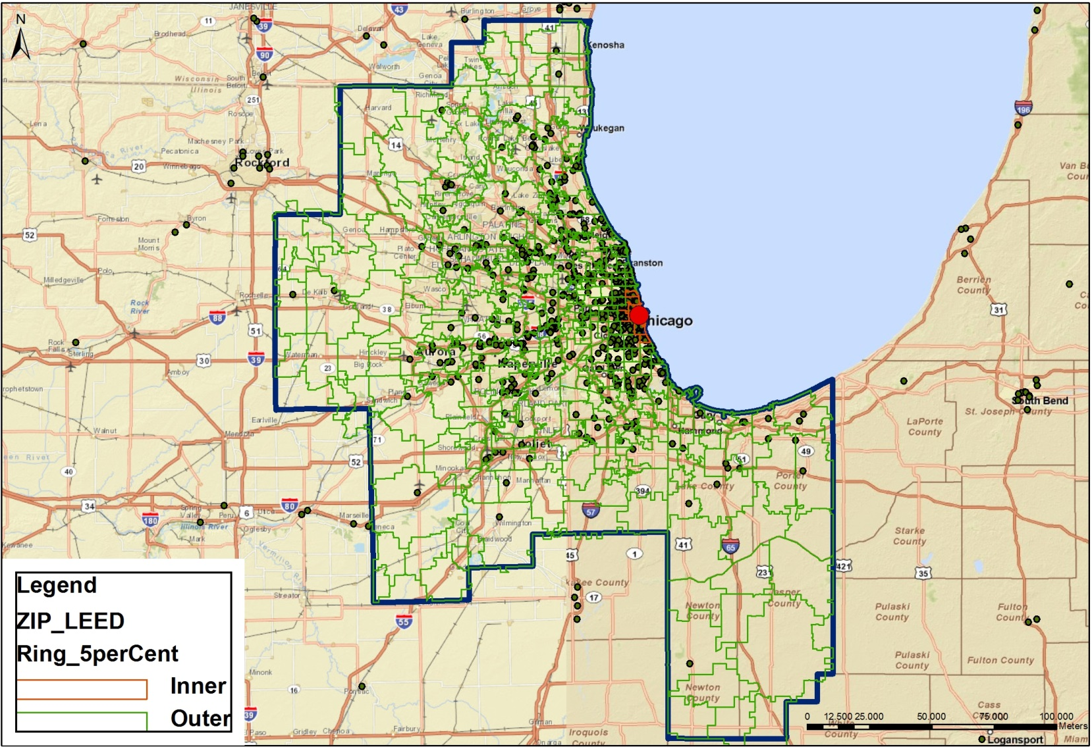

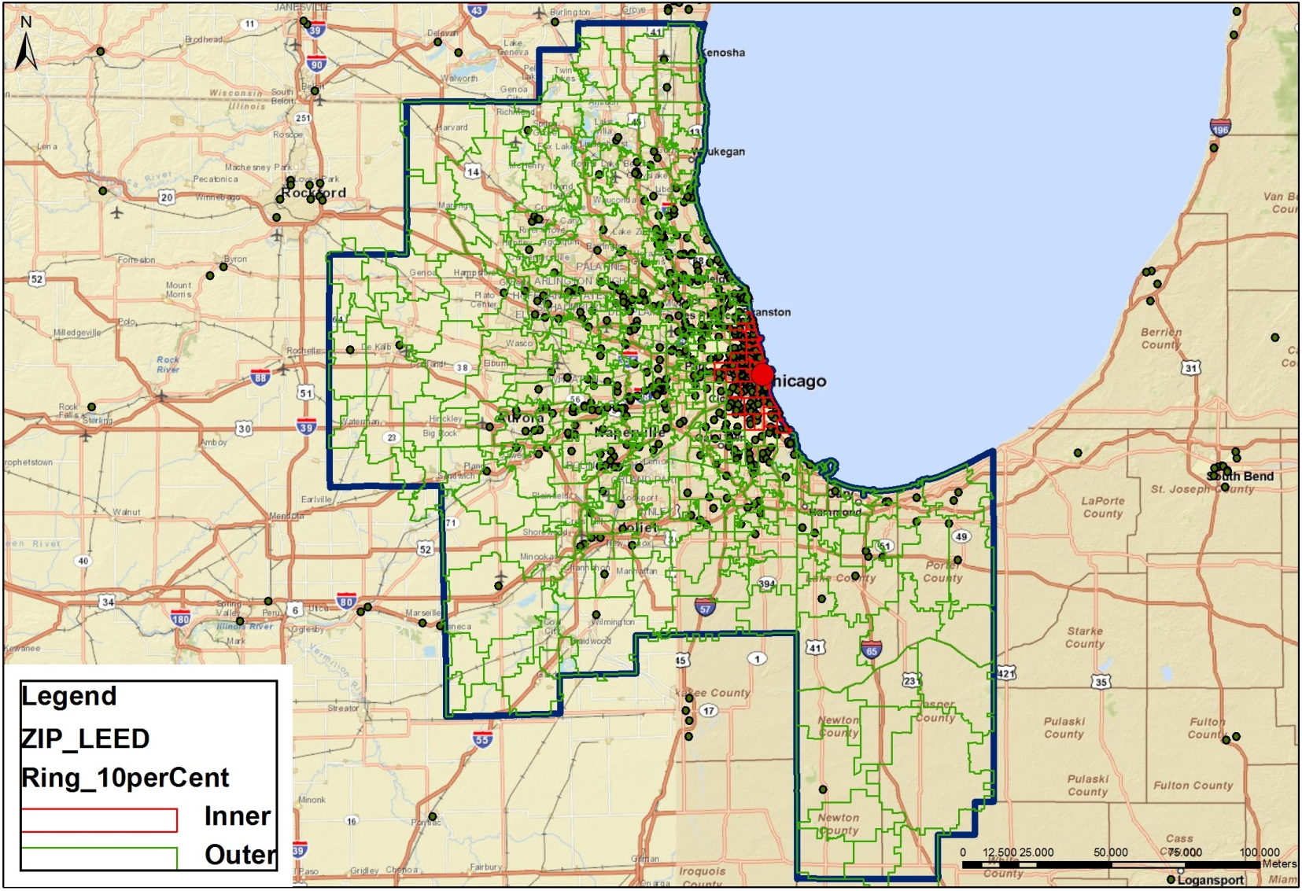
Research Approach
ZIP-Code Differentiation in the CBSA of Chicago (10%-, 5%- and 1%-Ring)
Notes:
In order to oppose the shares of LEED buildings and employment data within and beyond prime locations (10%, 5% and 1% of the prime zip-codes).

Slide 15
Results
Ratio of LEED Buildings and FIRE Service Establishments in Prime Locations in 2011
  Ratio of the shares of all existing LEED-buildings and FIRE service establishments within the 5%-ring of inner zip-codes in 2011 by registration year
  Disproportionally high share of LEED buildings in prime locations
  Also valid for the 10% or 1% inner zip-code rings
  Also valid for total employment, total establishments or general service establishments
Notes:
Erklären
Disproportionally high share of LEED buildings in prime locations in the US (orange) and the most of the CBSAs.
Validation done

Slide 16
Results
Mean Distance of the Green Buildings to the CBD in km in the US from 2000-2012
in km from CBD
  In general: centrifugal (i.e. hierarchical) diffusion
  From 2010-2012: centripetal tendency
  For mean distance of cumulative number of green buildings: slight decrease in 2011 and 2012 (decreasing number of new green buildings in 2011 and 2012)
  For relative distances (numerator: mean distance and denominator: maximal distance from the border of the CBSA to its CBD): similar results
  CBD
Notes:
Micro, dynamic view:
Mean distance to CBD in kilometers per year
Micro: there is hierarchical diffusion in areas beyond prime locations with respect to a centrifugal diffusion. From 2010-2012 probably financial crisis had centripetal diffusion with a return to more prime locations (also the number of new green buildings decreased during this period).
Regarding the mean distance of the cumulative green buildings to CBD in kilometers per year: it is increasing until 2010 with a slight decrease in 2011 and 2012 implicating the decreasing number of new green buildings in 2011 and 2012.
In order to control size effects, i.e. in order to make Chicago comparable with Albuquerque, we calculated the relative distance, i.e. the numerator is the absolute mean distance and the denominator is the maximal distance from the border of the CBSA to ist CBD.
The results are similar to the figures with regard to the absolute distance, yearly as well as cumulative.

Slide 17
Conclusion
„Labeled Properties = Prime Properties?“
  In which areas are green buildings actually located? Exclusively in prime locations?
  ➔ No, but predominantly and disproportionally high
  What happens, if markets in the initial stage (prime locations) are saturated? Do / will new markets (beyond prime locations) be entered by green buildings according to a hierarchical diffusion process? Are there already any indications?
  ➔ Yes, mean distance of green buildings was rising until 2010 according to a hierarchical diffusion process. However, in 2011 and 2012 the results are contrary.

Slide 18

Thomas Braun
Marcelo Cajias
Sven Bienert
IRE|BS Competence Center of Sustainable Real Estate
Universitätsstraße 31
D-93040 Regensburg
T: +49 941/943 6014
F: +49 941/943 816013
E: thomas.braun@irebs.de
www.irebs.de
Notes:
18

