Slide 1
A comparison of residential and commercial real estate values in polycentric cities
European Real Estate Society 21st Annual Conference 25th-28th June 2014
Aurélien DECAMPS
KEDGE Business School
aurelien.decamps@kedgebs.com
Frédéric GASCHET, Guillaume POUYANNE, Stéphane VIROL
GRETHA UMR CNRS 5113
University Montesquieu Bordeaux IV
frederic.gaschet@u-bordeaux4.fr
guillaume.pouyanne@u-bordeaux4.fr
stephane.virol@u-bordeaux4.fr

Slide 2
Presentation
Background
Aim of the paper
Method and Data
Results
Conclusion

Slide 3
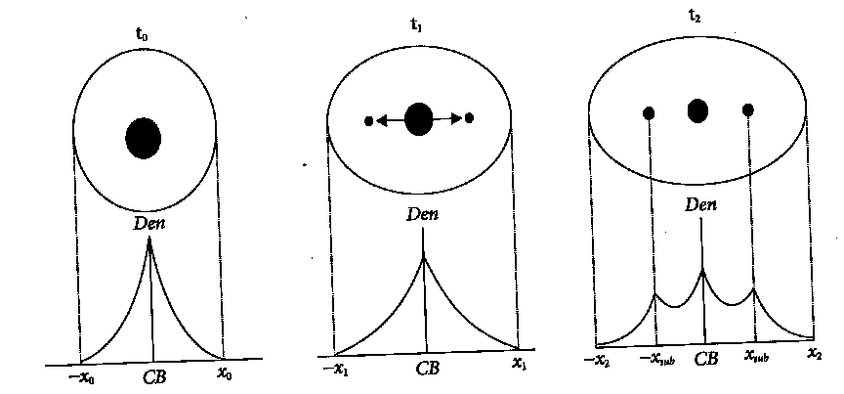
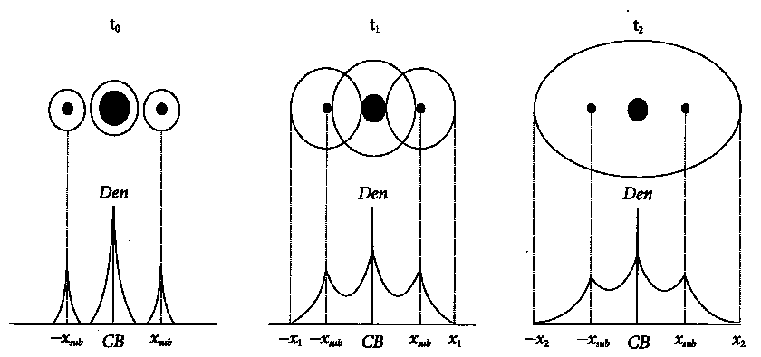
Background
The « polycentric city » :
  Emergence of subcenters (Giuliano and Small, 1991; Cervero and Wu, 1997; Bogart and Anderson, 2001)
  Economically specialized (Gaschet, 2001; Bingham and Kimble, 1995)
  Two types of subcenters (Muniz et al., 2009) :
    Suburbanization of jobs - Integration of remote medium-sized city

Slide 4
Background
Density polycentric gradients :
  A growing impact of subcenters on :
    Residential density (McMillen and McDonald, 1998)
    Job density (Small and Song, 1994)
The price gradient :
  Impact of centralities on real estate prices
    Residential prices: job accessibility and/or amenities (Ommeren et al, 1997; Brueckner et al, 1999)
    Commercial prices: firms’ proximity and agglomeration effects (Anas, Kim, 1996; Sivitanidou, 1996; Sasaki, Mun, 1997)
  The form of the gradient: spatial pattern of real estate prices in a polycentric city

Slide 5
Background
Price gradient regarding type of subcenters
Housing prices
Strong
complementarity
Medium
Complementarity
Strong
Substituability
CBD
Subcenter
Distance to the CBD

Slide 6
Aim of the paper
Comparison of the pattern of residential and commercial real estate prices in two french polycentric cities : Bordeaux and Lyon
  Do centralities have the same impact on residential and commercial prices or is there a differenciation between residential and economic centralities?
  The form of the gradient
    Complementarity vs. Substituability
    Spatial influence of each type centralities

Slide 7
Method and Data
A 3-steps approach :
  1. Identification of subcenters
  2. Hedonic model of housing and commercial prices in two polycentric cities
  3. Semi parametric regression to estimate the form of the price gradient (Geniaux, Napoleone, 2008; McMillen, Redfearn, 2010)
1. Identification of subcenters
  Giuliano and Small (1991)’s criterion : job density and minimum number of jobs (Geolocalized Data from INSEE)

Slide 10


Method and Data
2. A log linear hedonic model of housing and commercial prices
  Transaction prices and intrinsic characteristics: PERVAL (2000-2010)
  Location attributes (geolocalized database, INSEE and IGN)
    Median income, proximity with transport infrastructures, schools and universities, commercial and industrial areas, airport.
  3 Polycentric specifications
    Distance to CBD and each subcentres
    Distance to CBD and the nearest subcentre
    Genaralized job accessibility
3. Semi parametric regression: GAM (General Additive Model)

Slide 11
Results
Polycentric hedonic model
  Intrinsic characteristics and location attributes significant with the expected signs
  Strong impact of CBD : amenities + job accessibility
  Subcentres:
    Similarity between adjusted R² of polycentric and genralized accessibility models
    Strong impact of Arcachon for Bordeaux
    Residential prices : significant impact of several subcenters (number of jobs and specialization allowing complementarity with the CBD) and nearest subcenter
    Commercial prices : more selective impact of subcenters (job density and metropolitan functions)

Slide 12
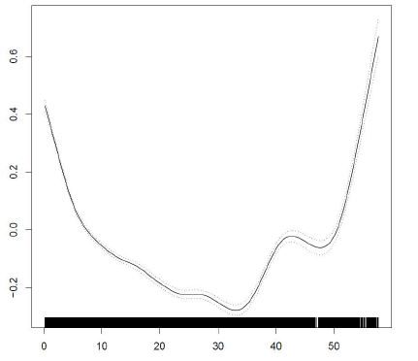
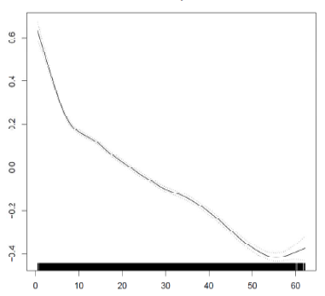
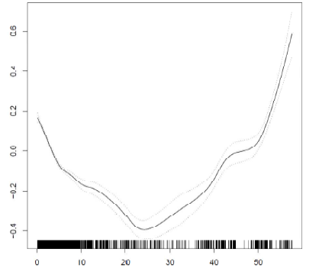
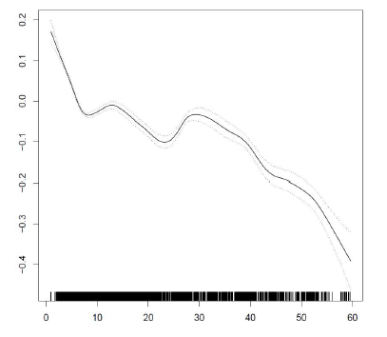
Houses - Bordeaux
Houses - Lyon
Dist_CBD
Dist_CBD
Appt - Bordeaux
Appt - Lyon
Dist_CBD
Dist_CBD

Slide 13
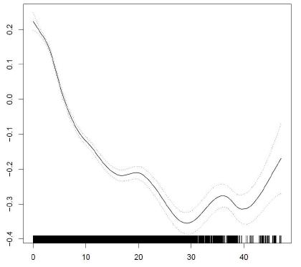
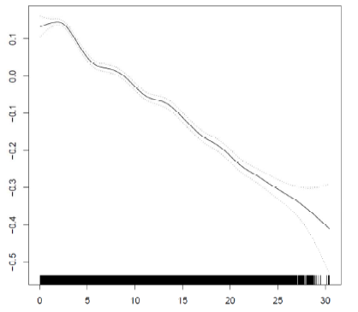
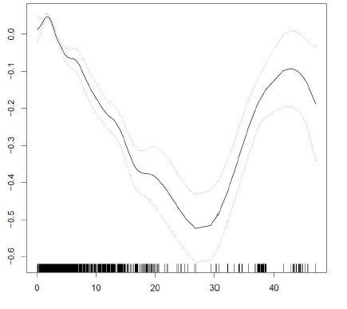
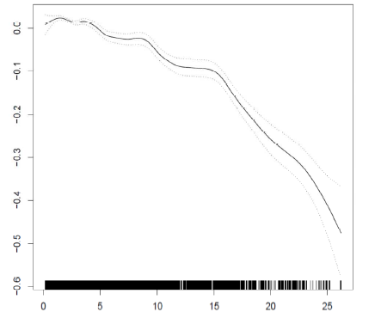
Houses - Bordeaux
Houses - Lyon
Dist_nearestSC
Dist_nearestSC
Appt - Bordeaux
Appt - Lyon
Dist_nearestSC
Dist_nearestSC

Slide 14
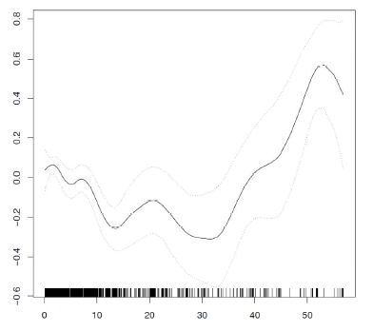
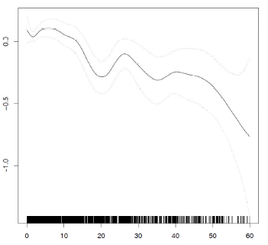
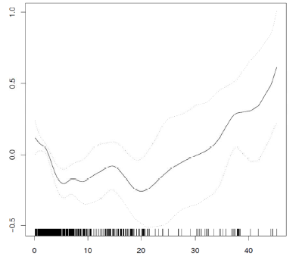
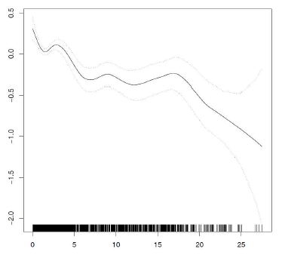
Commercial - Bordeaux
Commercial - Lyon
Dist_CBD
Dist_CBD
Commercial - Bordeaux
Commercial - Lyon
Dist_nearestSC
Dist_nearestSC

Slide 15
Conclusion
The polycentric structure of real estate prices is confirmed in the two cities
Differenciated impact of centralities:
  Residential prices: complementarity, mix of localized amenities and job accessibility
  Selectivity of commercial prices and substituability
  Different spatial extent between Bordeaux and Lyon, residential and commercial prices
Research perspectives
  Segmentation of sample between the several break-points of the price gradients to sharpen the analysis of spatial patterns of real estate prices
  Comparison with other metropolitan areas with different size (Ex: Paris)

